Slide 1
Intro to Web Apps
C393: Database Systems

Slide 2
Lesson Objectives
Build a simple website using a web framework

Slide 3
Web Frameworks
Make it easier to write, maintain, scale web apps
Designed for a particular audience
Often map requests → responses
Components
Frontend
Backend
Data Access Layer

Slide 4
Example Frameworks
Flask
Grails
Ruby on Rails
Spring MVC
Django
Angular

Slide 5
Framework Architecture
Each framework has its own “architecture” – way of viewing the world
Django uses a “Model – View – Template” architecture (MVT)
Model – maps between the database and the code representation
View – takes the model data and applies it to a template
Template – components used to build a page
In contrast, many others use a “Model – View – Controller” architecture(MVC)
Model – maps between database and code
View – presentation layer
Controller – handles interaction between view and model

Slide 6
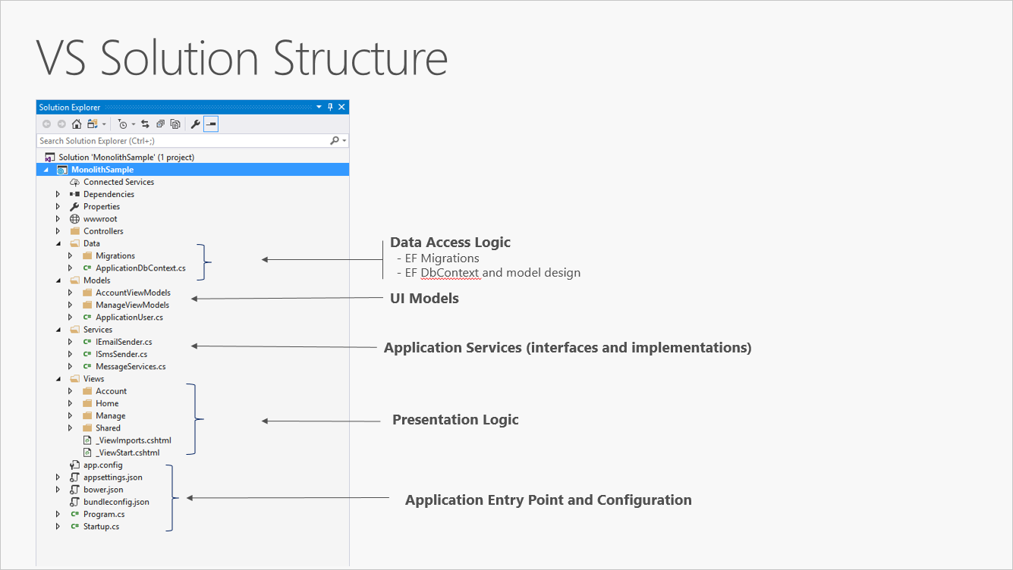
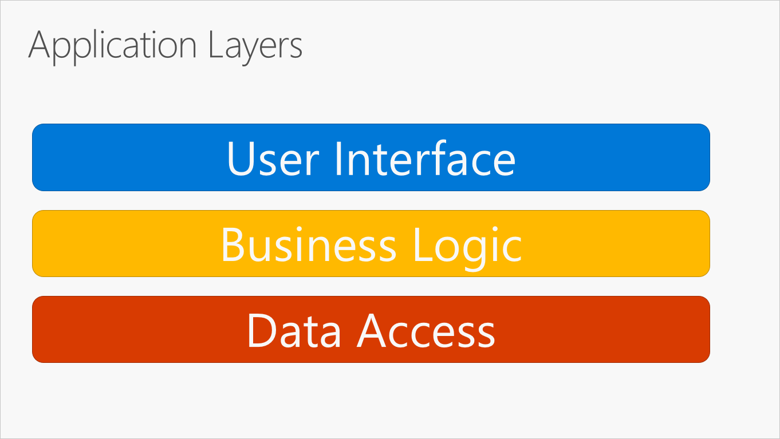
Framework Architecture
Notes:
https://learn.microsoft.com/en-us/dotnet/architecture/modern-web-apps-azure/common-web-application-architectures

Slide 7
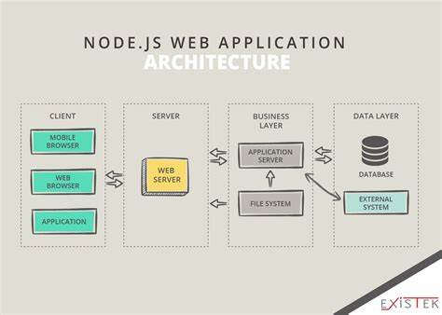
Physical Architecture
Client
Server
App server
Data

Slide 8
Physical Architecture
Final project
Client – web browser
Web server – Non-existent
Application server – Django
Data – MySQL

Slide 9
Following lessons
Django introduction (config / setup)
Django pages and templates
Django with MySQL
Django in-class exercise

